Slide 1




Hotel Aggregator Analysis
By Using Power bi
Created by Manar Sabri

Slide 2

Table of
Content
Geographical Insights
Pricing & Availability
1.
2.
Host Performance
Review Scores & Guest Satisfaction
3.
4.

Slide 3

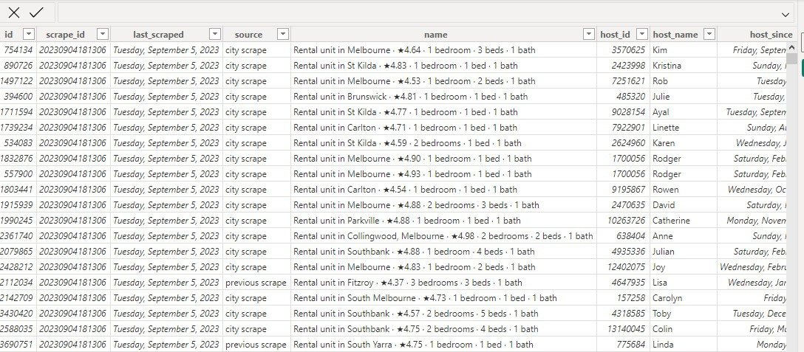
About Dataset

Slide 4
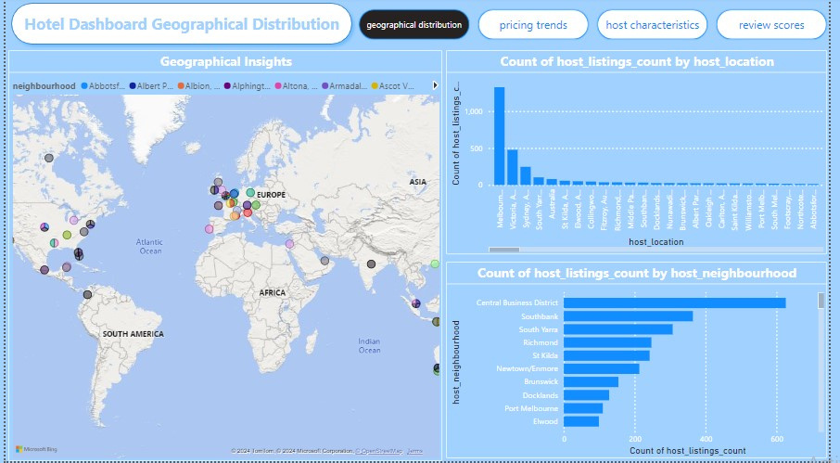
Geographical Insights

Slide 5
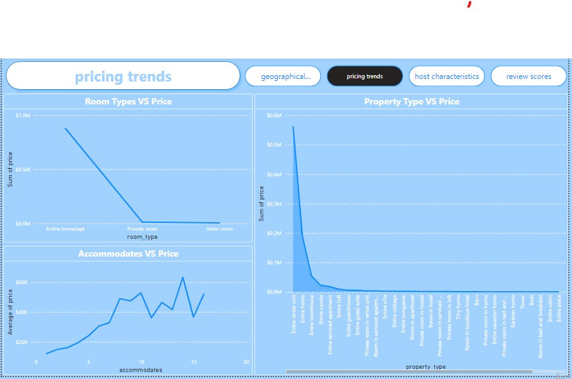
Pricing & Availability

Slide 6

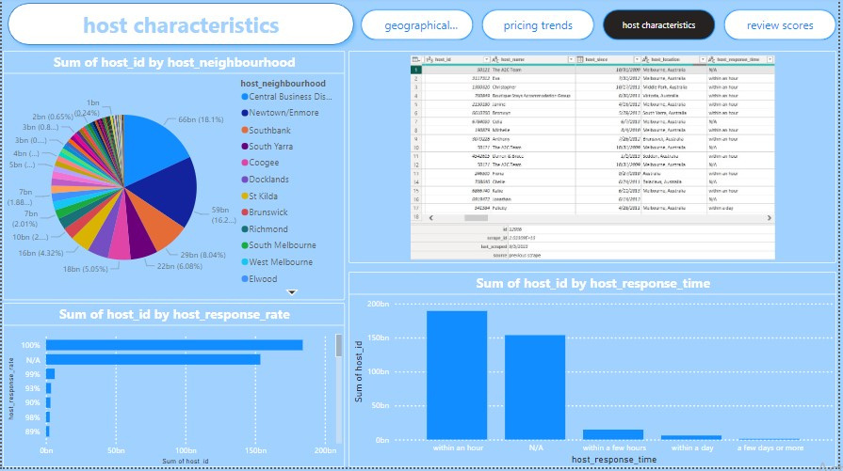
Host Performance

Slide 7
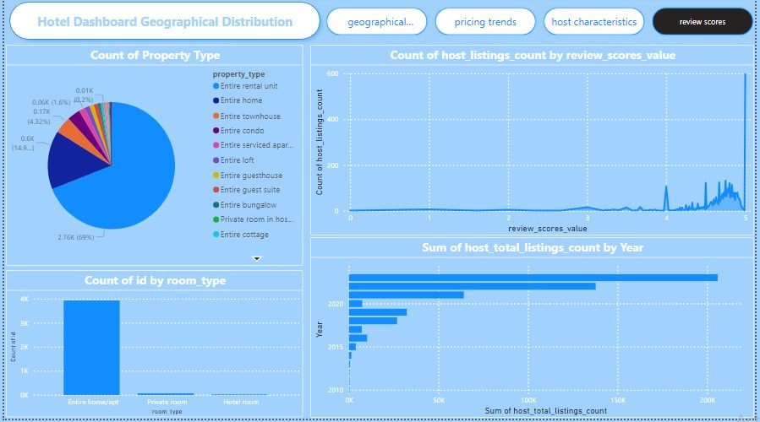
review scores

Slide 8
Recommendations
● High availability on certain dates, like September 5th in the data, could indicate
high demand. Increasing prices on these dates to maximize revenue could be a
good strategy.
● Data shows that entire homes/apartments are generally more expensive than
private rooms and hotel rooms. Offering more entire homes/apartments, if
feasible, could increase revenue.
● Consider seasonality in pricing and availability strategy. Prices might be higher
during peak tourist seasons and lower during off-peak times.

Slide 9
Recommendations
●Ensuring that guests’ expectations match their experiences can lead tohigher review scores and more bookings.
● Optimizing availability based on demand can help maximize bookings and revenue.
● Consider the lowest review ratings in communication and locations, then the factors behind this low ratings. Improve communication as one low rating can highly affect other ratings, like location.
● Note why some property or room types have high average total listings compared to others and find the common factors involving these types to improve.

Slide 10
Thank You

